Slide 1
Image Correctness For a Product on Marketplace
CSE7101- Capstone Project
Review-2
Batch Number: CIT_10
ROLL NUMBER | STUDENT NAME
20221CIT0006 | PR HEMESWAR RAJ
20221CIT0047 | MANASA T
20221CIT0048 | B DEEKSHITHA
Under the Supervision of,
Guide : Ms.Shivabasamma. Beli
Reviewer : Mr.Tanveer Ahmed
Name of the Program: CSE7101- Capstone Project
Name of the HoD: DrS P Anandaraj Sir
Name of the Program Project Coordinator:
Name of the School Project Coordinators: Dr. Sampath A K , Dr. Geetha A

Slide 2
Abstract:
Image correctness in online marketplaces refers to the accuracy, clarity, and compliance of product images with platform standards and customer expectations. High-quality, representative images are essential for enhancing buyer trust, reducing return rates, and maintaining the integrity of the marketplace. This evaluation focuses on ensuring that product images truthfully depict the item for sale, are free from misleading elements, and adhere to technical and content guidelines set by the platform.

Slide 3
Objective:
To assess whether product images:
Accurately represent the product being sold.
Meet platform-specific technical and content guidelines.
Avoid misleading visual elements (e.g., unrelated props, quantity misrepresentation).
Maintain visual clarity, proper framing, and appropriate background.
Contribute to a consistent and trustworthy shopping experience.

Slide 4
Existing Methods and Drawbacks:
Method | Description | Drawbacks
Manual Review | Humans check images for accuracy | Slow, costly, inconsistent, not scalable
Rule-Based Checks | Automated checks on size, format, background | Only catches basic errors; no content understanding
AI Image Models | ML models detect product type/features | Needs large data; errors on rare or new items
Text-Image Matching | AI compares images with titles/descriptions | Confused by similar items; needs tuning
Customer Feedback | Buyers report incorrect images | Reactive approach; user dissatisfaction occurs

Slide 5
Proposed Method and Feasibility:
1. Image Content Analysis (Computer Vision)
Detect product type, count, and visual quality
Identify misleading props, incorrect quantity
2. Text-Image Matching (Multimodal AI)
Use models like CLIP to compare image with title/description
Flag mismatches (e.g., "Red Dress" but shows Blue Shirt)
3. Rule-Based Validation
Resolution, format, background checks
Watermark/logo detection
4. Confidence Scoring
Combine all checks into a score (0–100)

Slide 6
Feasibility:
Technical Feasibility:
Uses pre-trained AI models (e.g., CLIP, YOLO)
Can be deployed on cloud or local servers
Integrates smoothly with existing marketplace systems
Operational Feasibility:
Requires minimal human review for unclear cases
Scales easily with growing listings
Fast processing with batch or real-time options
Economic Feasibility:
Moderate initial development cost
Manageable ongoing compute expenses
Reduces costs from returns and customer complaints

Slide 7
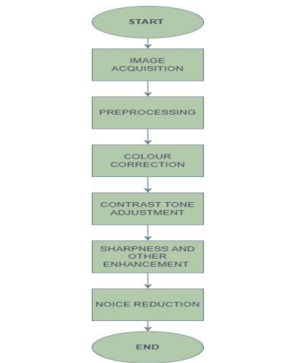
System Architecture:

Slide 8
System Modules:
1. Image Preprocessing
Resize, normalize, and clean input images
2. Object Detection Module
Identify product type and count items in the image
3. Text Processing Module
Extract and clean product title and description text
4. Text-Image Matching Module
Use AI (e.g., CLIP) to compare image content with text
5. Rule-Based Validation Module
Check image quality, resolution, background, and watermarks
6. Confidence Scoring Module
Combine outputs from all modules into a final correctness score
7. Decision & Action Module
Automatically accept, flag for review, or reject images based on score

Slide 9
Problem Statement:
Organization: Online E-Commerce Websites(Amazon,Myntra,Flipkart,Ajio)
Category : Software
Problem Description:
Product Name: Wireless Bluetooth Headphones – Noise Cancelling Over-Ear
Category: Electronics → Audio Devices
Description:
Experience high-quality sound with our Wireless Bluetooth Headphones designed for comfort and clarity. Featuring active noise cancellation (ANC), long-lasting 30-hour battery life, and cushioned over-ear design, these headphones are perfect for music, calls, and gaming.
Need for automated, scalable image validation
Incorrect or irrelevant product images
Manual moderation: slow, costly, and error-prone

Slide 10
Hardware and Software details:
Software Requirements
Language: Python
AI Models: CLIP, YOLOv8, BLIP
Frameworks: PyTorch or TensorFlow
Web/API: FastAPI or Flask
Text Tools: Hugging Face (for NLP)
Database: PostgreSQL or MongoDB
Optional: Docker (for deployment), Prometheus (for monitoring)
Hardware Requirements
Development Machine:
  16–32 GB RAM
  GPU (e.g., NVIDIA RTX 3060 or better)
Production Server / Cloud GPU:
  NVIDIA A10 or A100 (for large-scale use)
  32 GB+ RAM
  SSD Storage (1–2 TB)

Slide 11
Content
Expected Outcomes:
90%+ accuracy in detecting incorrect or low-quality images
Drastic reduction in manual moderation time
Enhanced trust among buyers due to higher image reliability
Higher approval rate of seller products on first upload
Lower product return rates

Slide 12
Github Link
Github Link
https://github.com/HMRAJ143/Image-correctness-for-a-product-on-marketplace.git

Slide 13
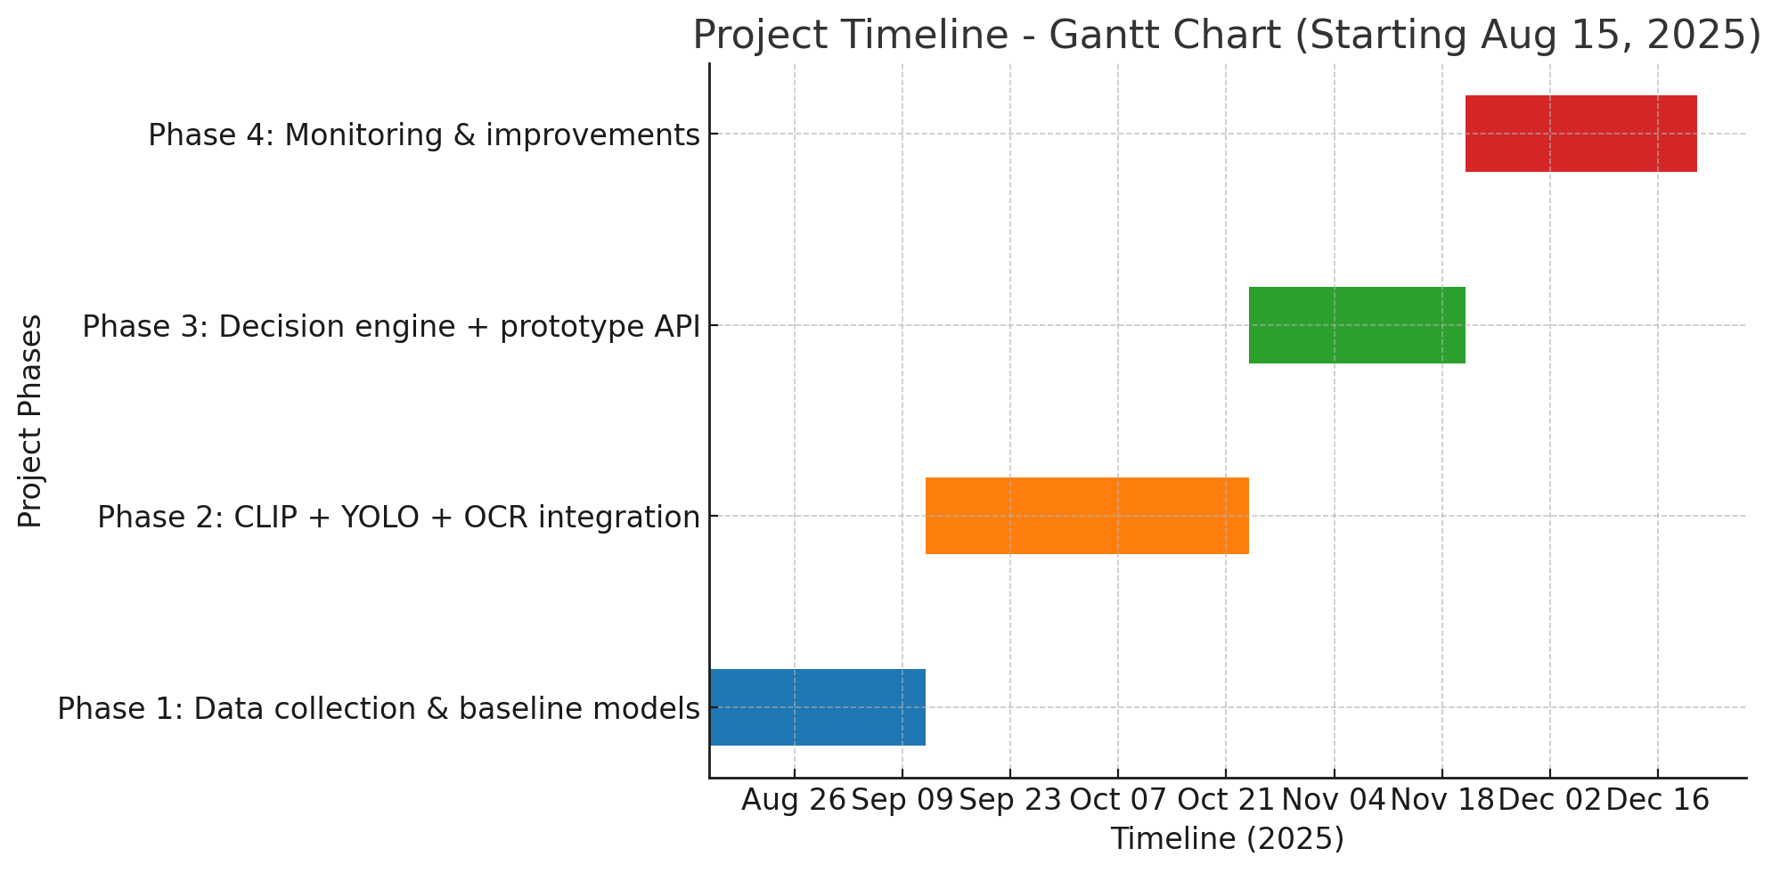
Timeline of the Project (Gantt Chart)

Slide 14
References (IEEE Paper format)
A. Krizhevsky, I. Sutskever, and G. E. Hinton, “ImageNet classification with deep convolutional neural networks,” Communications of the ACM, vol. 60, no. 6, pp. 84–90, Jun. 2017.
J. Redmon and A. Farhadi, “YOLOv3: An Incremental Improvement,” arXiv preprint arXiv:1804.02767, Apr. 2018.3.
A. Dosovitskiy et al., “An Image is Worth 16x16 Words: Transformers for Image Recognition at Scale,” arXiv preprint arXiv:2010.11929, Oct. 2020.4.
A. Radford et al., “Learning transferable visual models from natural language supervision,” in Proceedings of the International Conference on Machine Learning (ICML), 2021, pp. 8748–8763.

Slide 15


